Slide 1


WEB FUNDEMENTALS HTML

Slide 2


WHAT IS HTML?
HYPER TEXT MARKUP LANGUAGE
DESCRIBES THE STRUCTURE OF A WEB PAGE USING MARKUP (CODE FOR FORMATTING THE LAYOUT AND STYLE OF
ELEMENTS IN THE FORM OF TAGS)

Slide 3
!! HTML IS NOT A PROGRAMMING LANGUAGE !!
IT IS USED TO DEFINE STRUCTURE OF A WEB PAGE NOT THE FUNCTION. IT CONTAINS NO PROGRAMMING LOGIC

Slide 4
WHAT ARE TAGS?
TAGS DEFINE PIECES OF CONTENT ON A WEB PAGE
E.G. PARAGRAPHS, HEADINGS, IMAGES, LINKS, ETC.
<tag>…</tag>

Slide 5
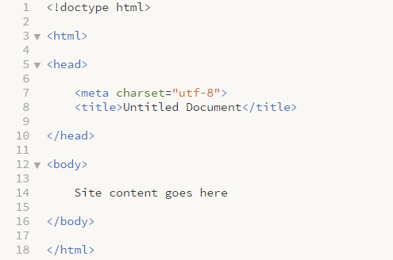
BASIC HTML STRUCTURE
<head></head>
Provides general information about the document (metadata)
<body></body>
Defines the body of the document (content)
Notes:
Discuss tags
<!doctype html> -
<html> -
Head tag –
Body tag -

Slide 6
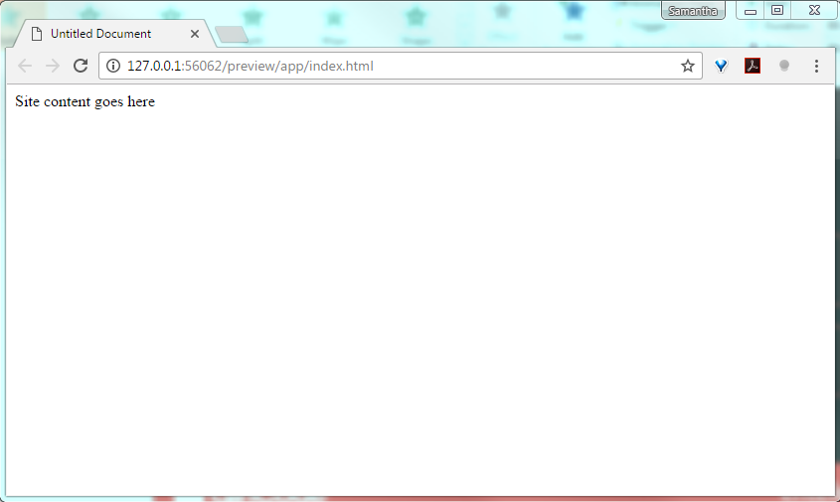
BASIC HTML STRUCTURE: RESULT

Slide 7
HTML vs. HTML5 TAGS
<div id=“header”>
<header>
<div id=“nav”>
<nav>
<div id=“section”>
<section>
<div id=“aside”>
<aside>
<div id=“article”>
<article>
<div id=“footer”>
<footer>
Notes:
Before HTML5 most containers were structured as div’s
One of HTML5’s focuses was on scemantics

Slide 8
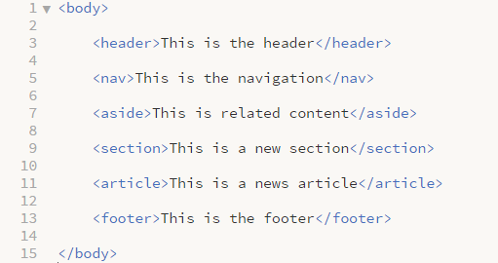
HTML STRUCTURE
<header>
<nav>
<section>
<aside>
<article>
<footer>

Slide 9
COMMONLY USED TAGS: CONTAINERS
TAG | TAG DESCRIPTION
<header></header> | Defines the header portion of the page
<footer></footer> | Defines the footer portion of the page
<nav></nav> | Defines the navigation portion of the page
<section></section> | Defines a section of the page
<article></article> | Defines a self contained article
<main></main> | Defines the main content portion of the page
<aside></aside> | Defines a portion of the page related to the main content
<div></div> | Defines a generic section of the page
<hr> | Defines a thematic change – draws a horizontal line
Notes:
Briefly discuss tabs
Define general structure of the site (containers)

Slide 10
COMMONLY USED TAGS: FORMATTING
TAG | TAG DESCRIPTION
<h1></h1> | Defines a heading: <h1> - <h6>
<p></p> | Defines a paragraph
<blockquote></blockquote/> | Defines a quotation
<em></em> | Italic
<strong></strong> | Bold
<br/> | Inserts a single line break
<ol>ol> | Defines an ordered list (1,2,3)
<ul></ul> | Defines an unordered list (Bulleted)
<table></table> | Defines a table with 1 row (tr) and 1 col (td)
<a></a> | Defines an anchor, usually to add a link
<img> | Defines an image
<span></span> | Groups inline elements
Notes:
Discuss tags – used for formatting
Tags can be nested

Slide 11
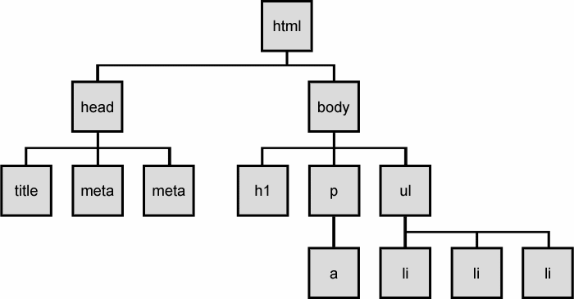
THE DOCUMENT OBJECT MODEL

Slide 12
HTML ATTRIBUTES
ALL HTML ELEMENTS (TAGS) CAN HAVE ATTRIBUTES WHICH PROVIDE EXTRA INFORMATION ABOUT THE ELEMENT
<tag attribute name = “value”>…</tag>

Slide 13
COMMON HTML ATTRIBUTES
ATTRIBUTE | ATTRIBUTE DESCRIPTION
title | Title value will be displayed as a tooltip on mouse over
href | Specifies the link address within an anchor tag
width, height | Specifies an element’s width and height
alt | Specifies an alternative text to be used when an element can’t be displayed
id | An HTML selector. ID’s are unique and only one ID can only be used on one element
class | An HTML selector. Classes are not unique and multiple classes can be used on multiple elements
src | Points to an external file (source file)
target | Specifies where to open the linked document

Slide 14
ID’S AND CLASSES
ID’S AND CLASSES ARE SELECTORS BUT
ONLY ONE ID CAN ONLY BE USED ON ONE ELEMENT
MULTIPLE CLASSES CAN BE USED ON MULTIPLE ELEMENTS

Slide 15
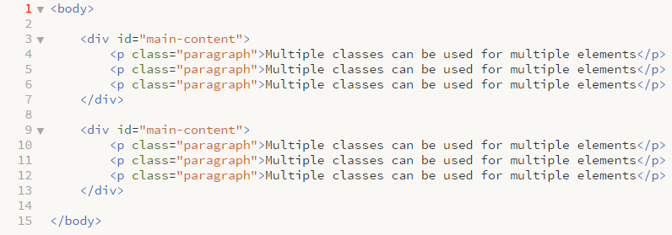
ID’S AND CLASSES
Notes:
- Can’t use the same div twice

Slide 16
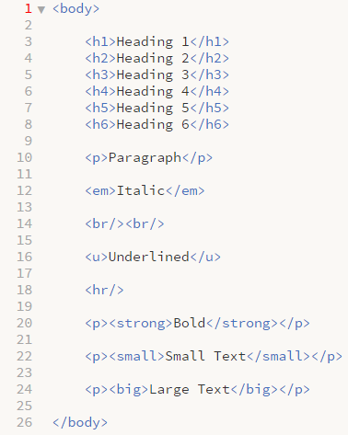
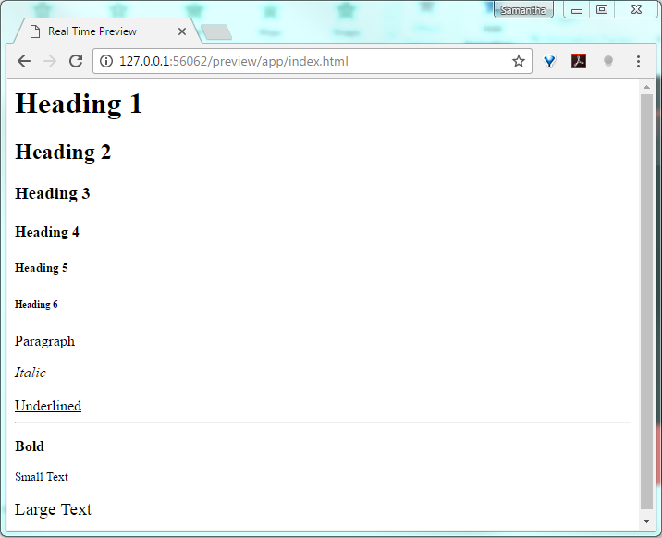
EXAMPLES: TEXT FORMATTING

Slide 17

EXAMPLES: IMAGES

Slide 18

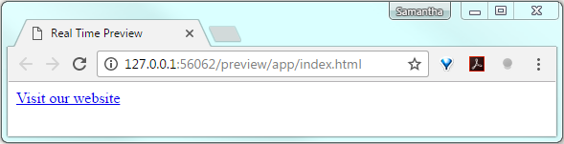
EXAMPLE: LINKS

Slide 19
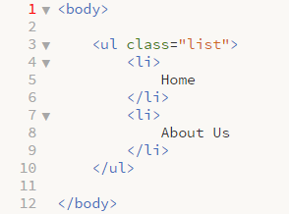
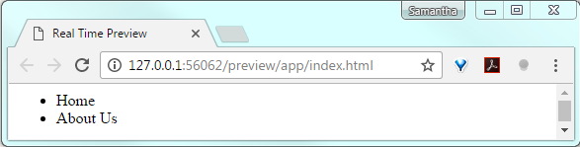
EXAMPLE: UNORDERED LISTS

Slide 20
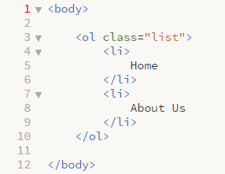
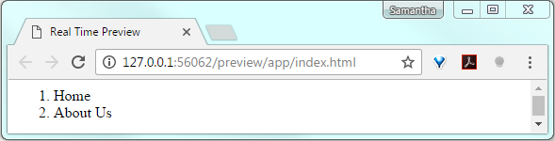
EXAMPLE: ORDERED LISTS

Slide 21
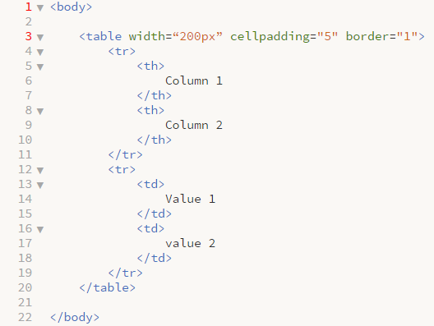
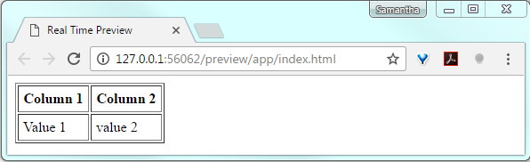
EXAMPLE: TABLES

Slide 22
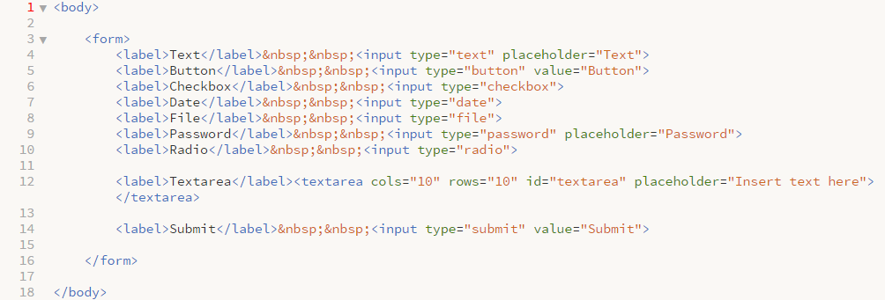
EXAMPLE: FORMS

Slide 23
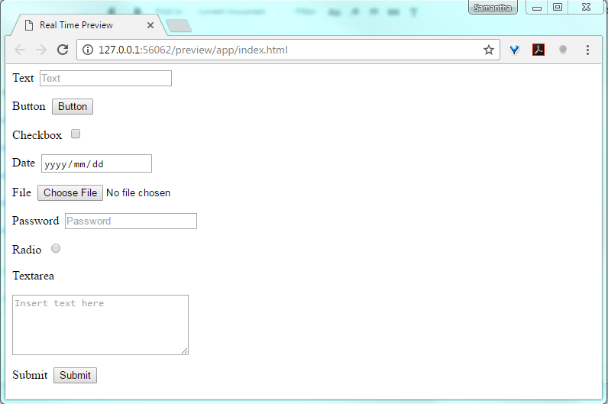
EXAMPLE: FORMS

Slide 24
BLOCK & INLINE ELEMENTS
BLOCK LEVEL ELEMENTS ALWAYS START ON A NEW LINE AND TAKE UP THE FULL WIDTH OF THEIR CONTAINER
E.G. <div>, <h1> - <h6>, <p>, <form>
INLINE ELEMENTS DO NOT START ON A NEW LINE AND ONLY TAKE UP AS MUCH SPACE AS IS NECESSARY
E.G. <span>, <a>, <img>

Slide 25
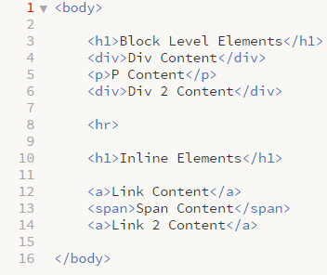
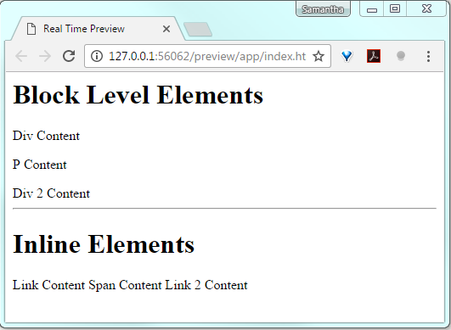
EXAMPLE: BLOCK & INLINE ELEMENTS

Slide 26
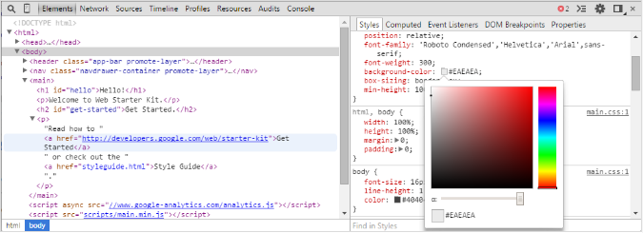
DEVTOOLS
Notes:
Demo

Slide 27
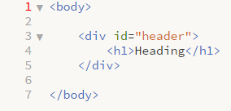
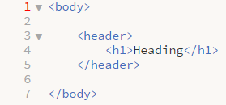
GOOD VS. BAD CODE
DESCRIPTIVE BLOCKS DESCRIBING CONTENT CONTAINED
Notes:
Brief Introduction

Slide 28
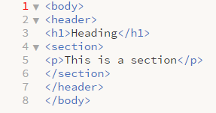
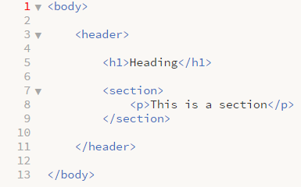
GOOD VS. BAD CODE
INDENTATION TO DECIFER PARENT CHILD RELATIONSHIPS
Notes:
Brief Introduction

Slide 29
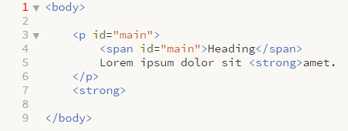
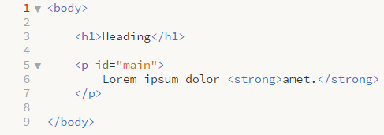
GOOD VS. BAD CODE
USE OF AN ID TWICE, HEADING NOT IN A HEADING TAG AND
INCORRECT ORDERING OF TAGS
Notes:
Brief Introduction

Slide 30

Notes:
Brief Introduction

Slide 31
REFERENCES
https://css-tricks.com/examples/CleanCode/Beautiful-HTML.png
http://webdesignfromscratch.com/html-from-scratch/
https://www.w3schools.com
http://www.danfergusdesign.com/classfiles/generalReference/html5reference.php
https://developer.mozilla.org/en/docs/Web/HTML/Element/head
https://css-tricks.com/the-difference-between-id-and-class/
https://developer.chrome.com/devtools
https://developer.mozilla.org/en/docs/Web/Guide/HTML/HTML5
http://www.webstepbook.com/supplements/slides/ch08-dom.shtml
http://memeshare.xyz/media/html-memes
Notes:
Brief Introduction

Slide 32
PRACTISE EXERCISE RESUME
CREATE A SINGLE PAGE ONLINE RESUME CONTAINING THE FOLLOWING:
A HEADER CONTAINING YOUR NAME
A SECTION FOR YOUR PROFILE PICTURE AND ANY OTHER INFO YOU MAY LIKE TO ADD
A SECTION FOR YOUR RESUME CONTENT CONTAINING THE FOLLOWING:
AT LEAST 1 HEADING
MAIN RESUME CONTENT
A LIST
A FOOTER WITH YOUR CONTACT DETAILS
Notes:
Brief Introduction

